Slide 1
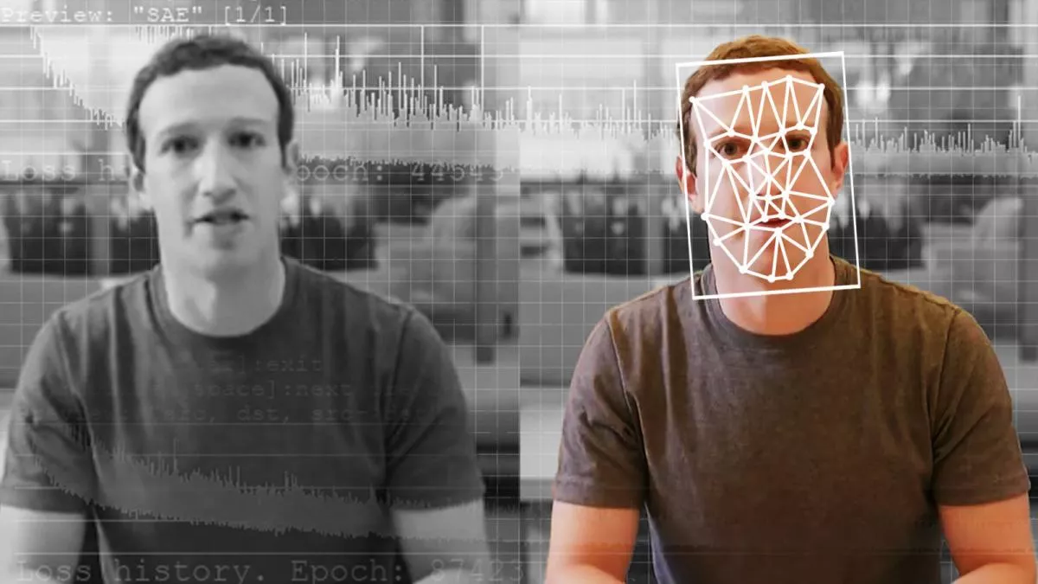
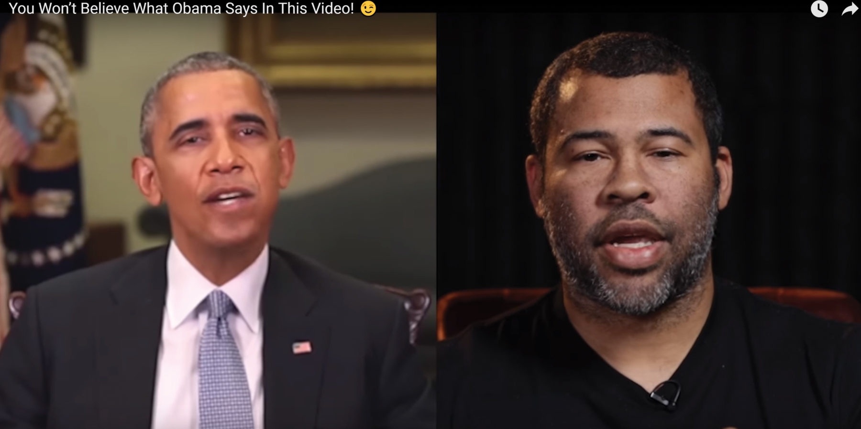
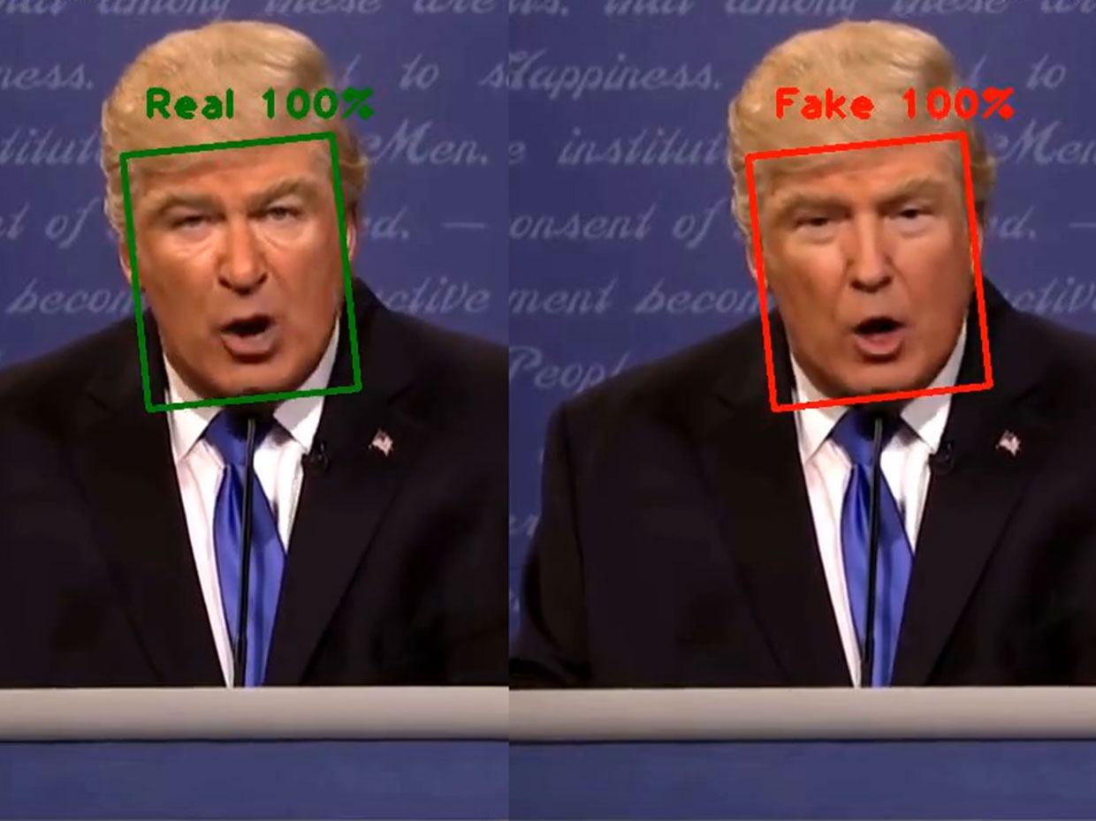
Deep Fake Detection
Adithi Loka
Selvakumar Jayaraman
Swayanshu Shanti Pragnya
Way to know what's factual or not: Detect and Compare

Slide 2
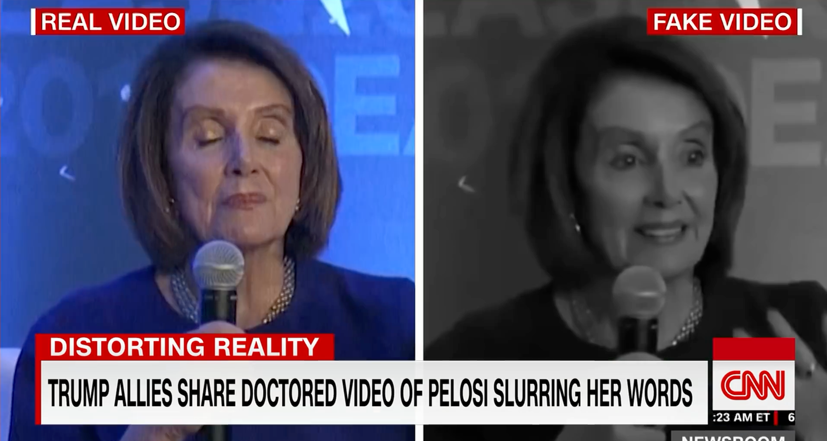
Problem Statement
Deepfakes can distort our perception of the truth and we need to develop a strategy to improve their detection. Deep Fakes are increasingly detrimental to privacy, social security, and democracy. We plan to achieve better accuracy in predicting real and fake videos.
What is a Deep-fake?
Using Artificial Intelligence and Deep Neural Networks for synthetically manipulating or generating fake videographic content

Slide 3
Examples-
A sample of videos from Google’s contribution to the FaceForensics benchmark. To generate these, pairs of actors were selected randomly and deep neural networks swapped the face of one actor onto the head of another.

Slide 4
Motivation
-Deepfakes are increasingly detrimental to privacy, social security, and democracy.
-We plan to achieve better accuracy for classifying real and fake videos.
Example-
Recently a video on social media has shown that a high ranked U.S legislator declared his own support for an enormous tax increase. At this point, people might tend to react accordingly because the video is exactly the same as the person by looks and voice.
This way, DeepFake content can be used to manipulate people’s opinions. So, Deepfakes detection plays a prominent role in identifying fake content on social media.

Slide 5
Data
Dataset: https://www.kaggle.com/c/deepfake-detection-challenge/data
The dataset contains 470 GB of video files(training and testing) and a metadata file for each video.
We plan to use 100 videos from the dataset, and divide them to 70% training, and 30% test and evaluate the models on that. We plan to develop a model that generalizes well.
Columns in metadata file:
filename - the filename of the video.
label - whether the video is real or fake.
original - in the case that a train set video is fake, the original video is listed here.
split - this is always equal to "train

Slide 6
Pre-processing
Videos to frames Conversion - Captured frames using VedioCapture class of cv2 library from a video.
Individual Video length (8 seconds) → 300 Frames
Frames to Faces - We explored dlib, MTCNN and Facenet to detect faces in frames and saved the face. We hope that the faces are important features to identify fake and real images.
Resized images to 86*86 RGB(We tried different size settings and gray scale based on models structures).
To leverage discrepancies across frames, we saved each videos frame images sequentially inside a single folder across the pipeline of data preprocessing, So that we could use it for LSTM if needed. For CNN and GAN’s this doesn’t really matter.

Slide 7
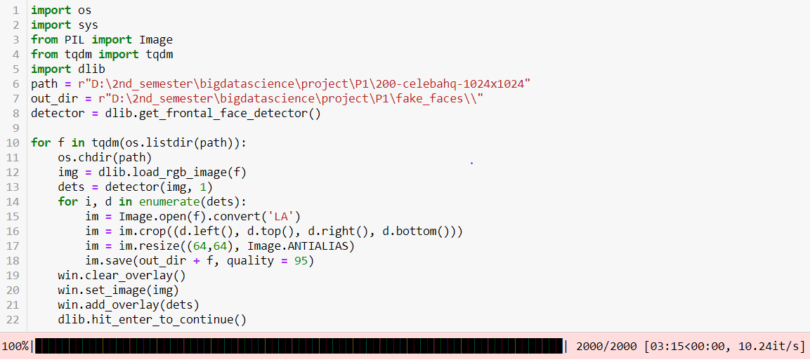
Resize, Compression, Face Landmark Detection and Grey Scale Conversion
We resized images to different sizes like 256*256 with entire frame, 128*128 face only, 64*64 face only, 84*84 face only and trained them to pick the best configuration.
We also explored training on RGB images and gray scale images. GAN had a performance improvement on generating high quality images in lesser epochs for Gray scale images, and it was intuitive that RGB would take time to learn complex features as the dimensions increase three times.

Slide 8

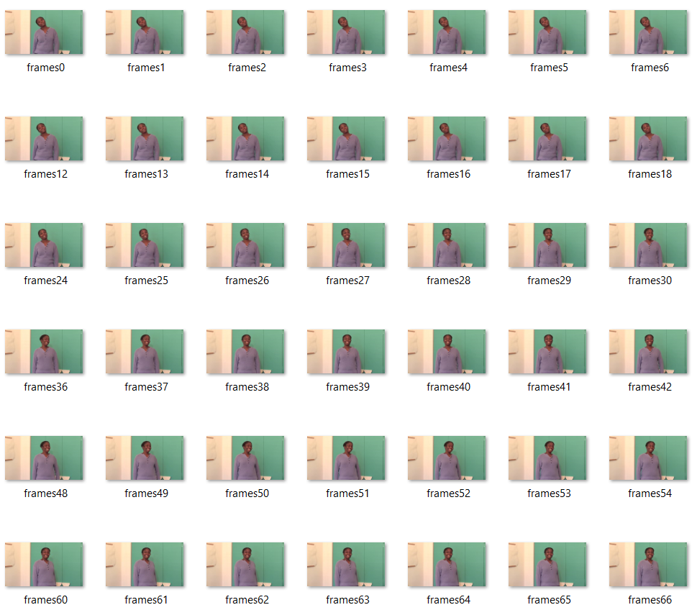
Video → Frame Sample
Video(29.97 frames/second) Frame(1920x1080, 96 dpi)

Slide 9
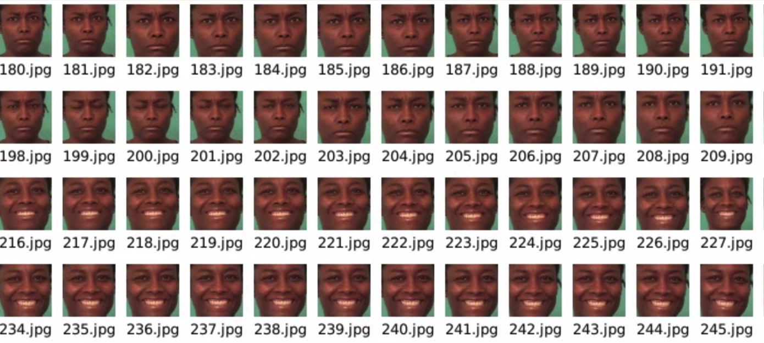
Frame → Face

Slide 10
Methodologies Explored
CNN Classifier
Paper based implementation: CGFace
Intuition is to learn dense facial features of a given image, and acquire knowledge to classify real and fake images.
Based on the classification made for a given image, we extend it to predict a full video by predicting all faces or sample of faces in the given video.
DCGAN
GAN is the novel technique for generating and discriminating fake images
We referred DCGAN paper and modified the network to match our image resolution with a aim to build discriminator that would classify real and fake images of our dataset

Slide 11
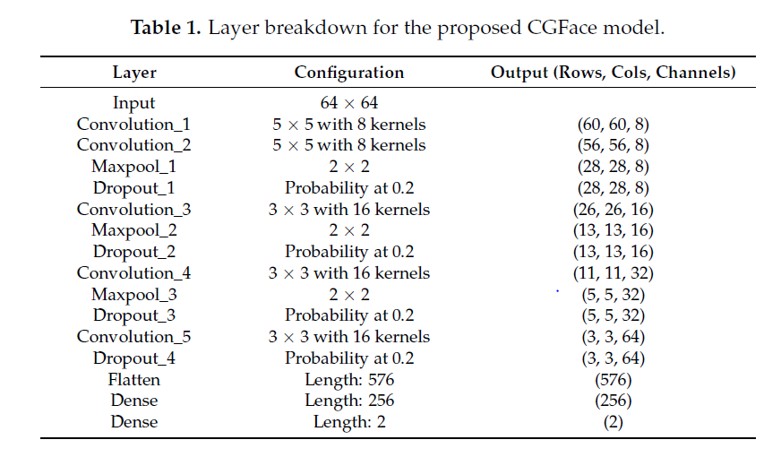
CGFace Model - CNN classifier

Slide 12
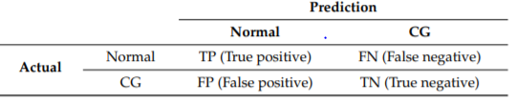
CGFace Model Explanation
What is CGFace? It is a computer-generated face detection task by customizing the number of convolutional layers, so it performs well in detecting computer-generated face images. Adding to that an imbalanced framework (IF-CGFace) is created by altering CGFace’s layer structure to adjust to the imbalanced data issue by extracting features from CGFace layers and use them to train AdaBoost.
Batch Normalization: Before the fully connected layers, one batch normalization layer was added the reason was to improve optimization by introducing some noise into the network so that it can regularize the model besides the dropout layers.
Optimization algorithm:Adam, learning rate : 0.001, batch size: 32, and 50 epochs

Slide 13
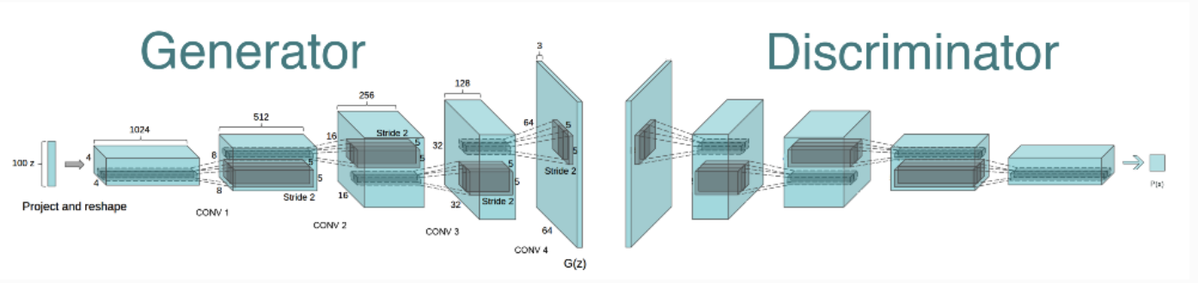
DCGAN

Slide 14
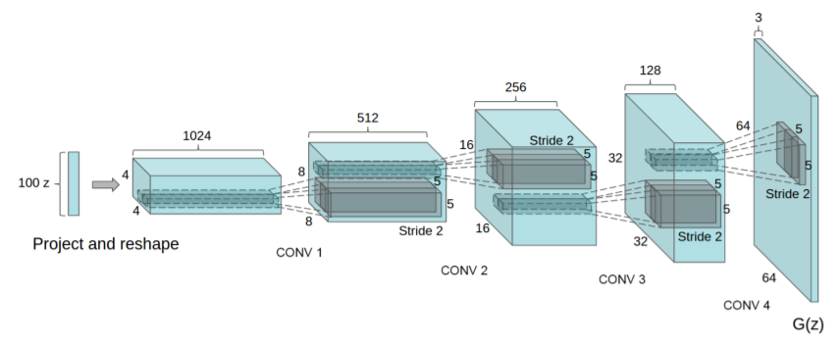
Architectural Guidelines for DCGAN
Methods for Deep Convolutional GANs
Replace any pooling layers with strided convolutions (discriminator) and fractional-strided convolutions (generator).
Use batchnorm in both the generator and the discriminator.
Remove fully connected hidden layers for deeper architectures.
Use ReLU activation in generator for all layers except for the output, which uses Tanh.
Use LeakyReLU activation in the discriminator for all layers.

Slide 15
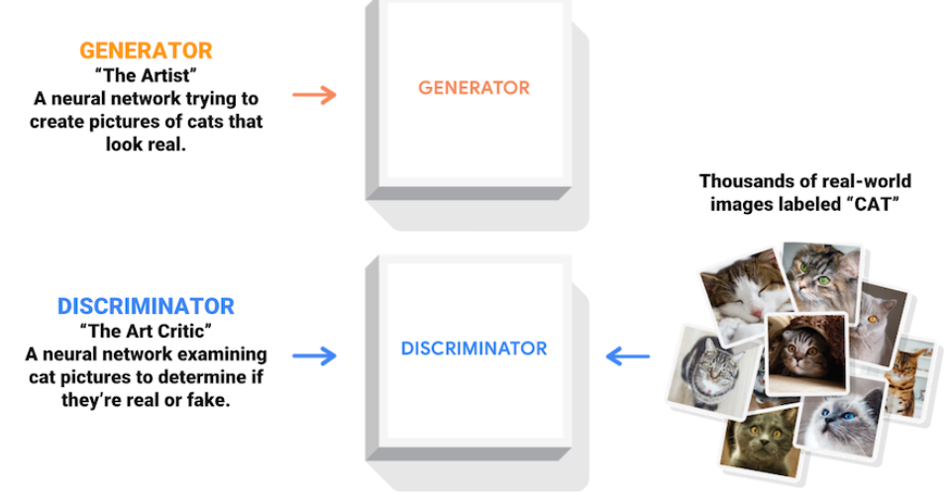
DCGAN - Implementation
We modified the architecture with different kernel sizes and number of kernels, for processing the face image that we have of size 84*84*3.
Generator: We gave a 100 dimension noise vector, this was based on other research papers that have successfully implemented GAN’s and other variants of GANS
Discriminator: We built it to accept the 84*84*3 image with 2 convolution layers, and a fully connected layer activated by Leaky ReLu to make prediction. Zero means fake and one means real.

Slide 16
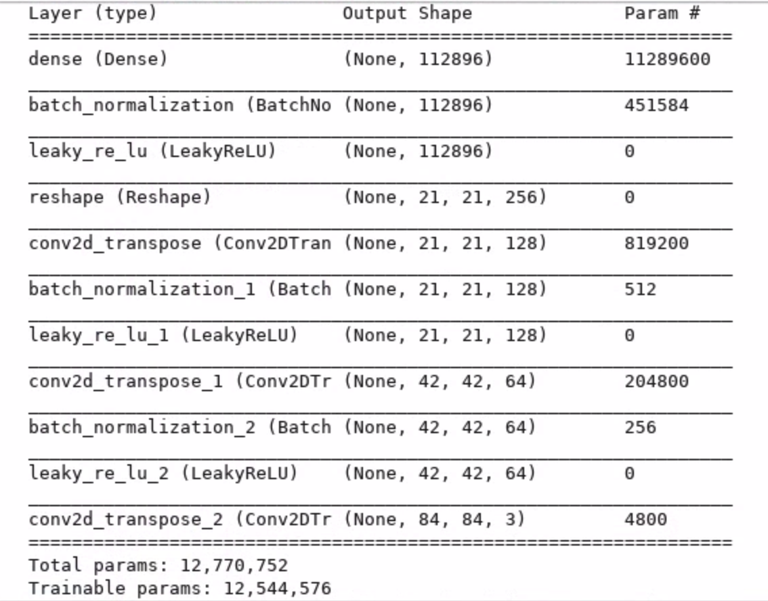
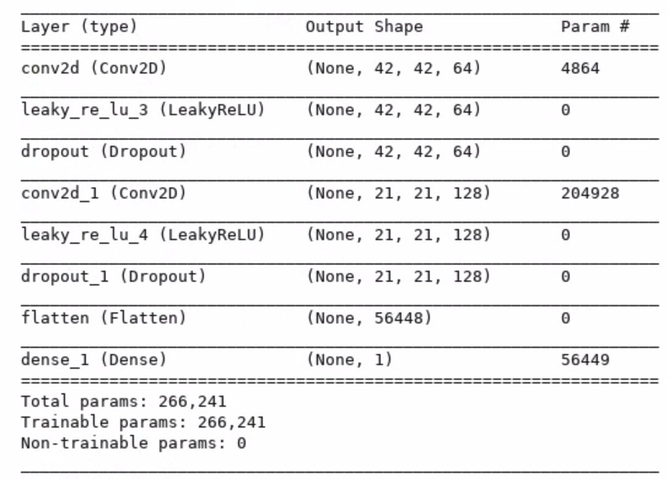
Generator
Discriminator

Slide 17
Method that we could not implement
Meta learning based CNN classifier
We hoped that we could build a MAML based CNN classifier that uses previous knowledge of similar tasks, learnt during meta training process and could generalize well to the new task with lesser samples.
We tried different dataset as similar tasks - Male vs Female, Human vs Horse, etc., in a hope that model will learn facial features and it would be easy to adapt to Real vs Fake class.
Problem?
We could not find much of data, and so we did not see much of improvement in meta learning. Finally we modified entire imagenet dataset as 2-way for meta training process(even though it does not have human features) in a hope that model would learn binary classification of images and it could be extended. But it did not work well too, it was memory extensive and the vm instance terminated many times during training.

Slide 18
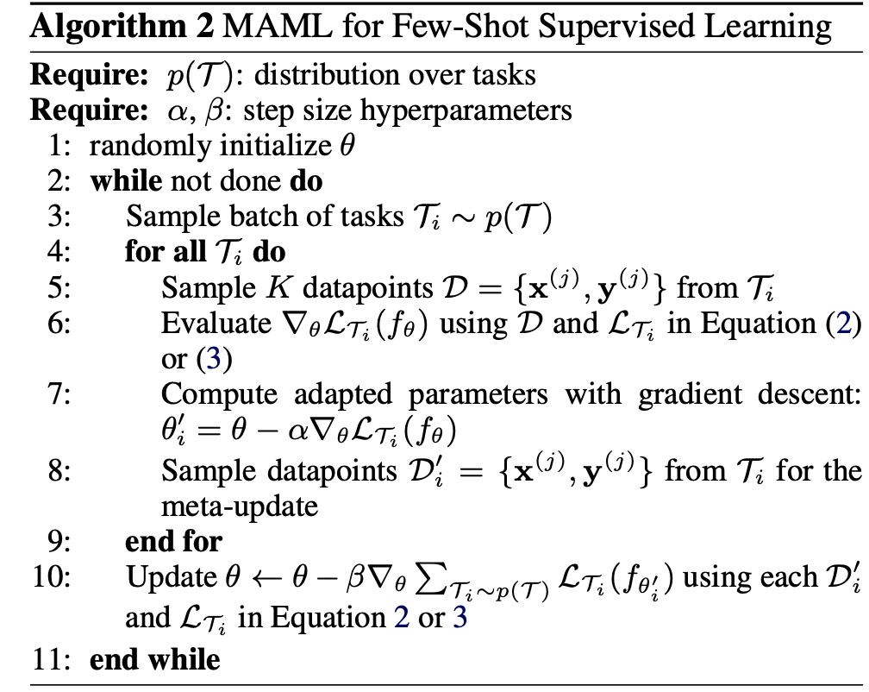
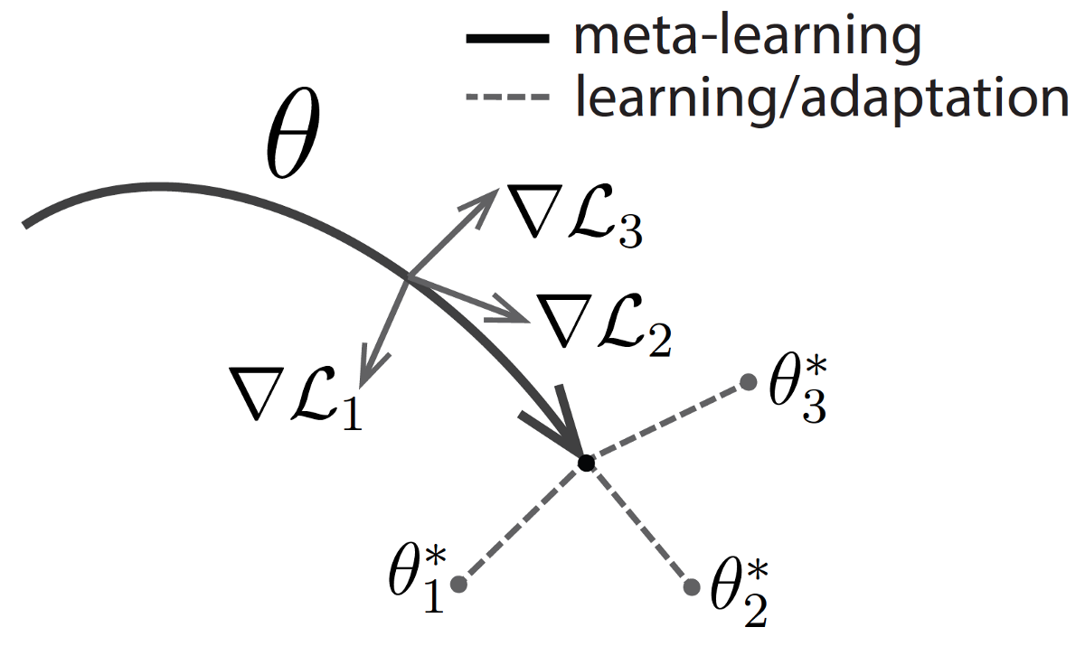
MAML Algorithm

Slide 19

Tools
Python - Programming language
Dlib, Facenet, MTCNN - Face detection
CV2 - Image and Video processing
Tensorflow - Deep learning library
Keras - Deep learning library
Machine configuration for training: Google deep learning VM instance 13 GB RAM, 500 GB storage, 2 vCPUs, 1 x NVIDIA Tesla K80

Slide 20
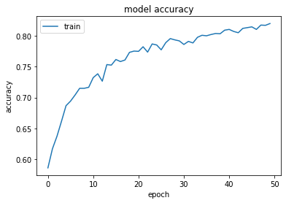
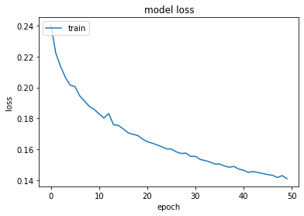
Results- Baseline Model

Slide 21
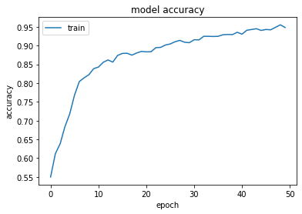
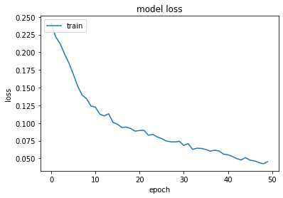
CGFace Model

Slide 22
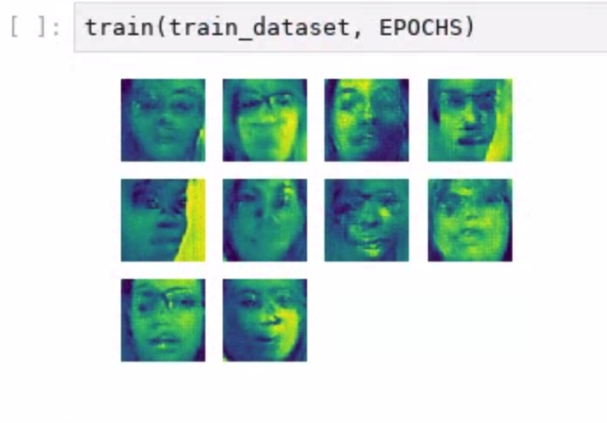
DCGAN - Images at 1000th epoch

Slide 23
Summary
Model | Training Accuracy | Testing Accuracy
Baseline model | 82.022 | 62.9333
CGFace | 94.822 | 68.2777
DCGAN | NA | 50

Slide 24
Lessons Learned
We hoped meta learning would require less parameter tuning and simple models would perform well. But our assumption turns out to be wrong as for meta-training to go well, we might have to tune the parameters well and we might have to do it dynamically too to achieve best performance.
We learnt that MAML++ approach overcomes this limitation to a certain extent.
For GAN’s to perform well with high dimensional images, and to train directly on videos using conv3d layers, we need a lot of computing resources.
For videos, a single epoch could take up to days.
It is always a best practice to save weights and create checkpoints during training, we learned it the hard way as we lost our gan weights once which was trained for 2500+ epochs.

Slide 25
References
CGFace - https://www.mdpi.com/2076-3417/8/12/2610/htm
DCGAN - https://arxiv.org/pdf/1511.06434.pdf
MAML - https://arxiv.org/pdf/1703.03400.pdf
Blink detection network using CNN and LSTM - https://arxiv.org/pdf/1806.02877.pdf
Recurrent Convolutional Strategies for Face Manipulation Detection in Videos - https://arxiv.org/pdf/1905.00582.pdf
Deep Learning Based Computer Generated Face Identification Using Convolutional Neural Network(CGFace) - https://www.mdpi.com/2076-3417/8/12/2610/htm
MesoNet: a Compact Facial Video Forgery Detection Network - https://hal-upec-upem.archives-ouvertes.fr/hal-01867298/document

